Slide 1
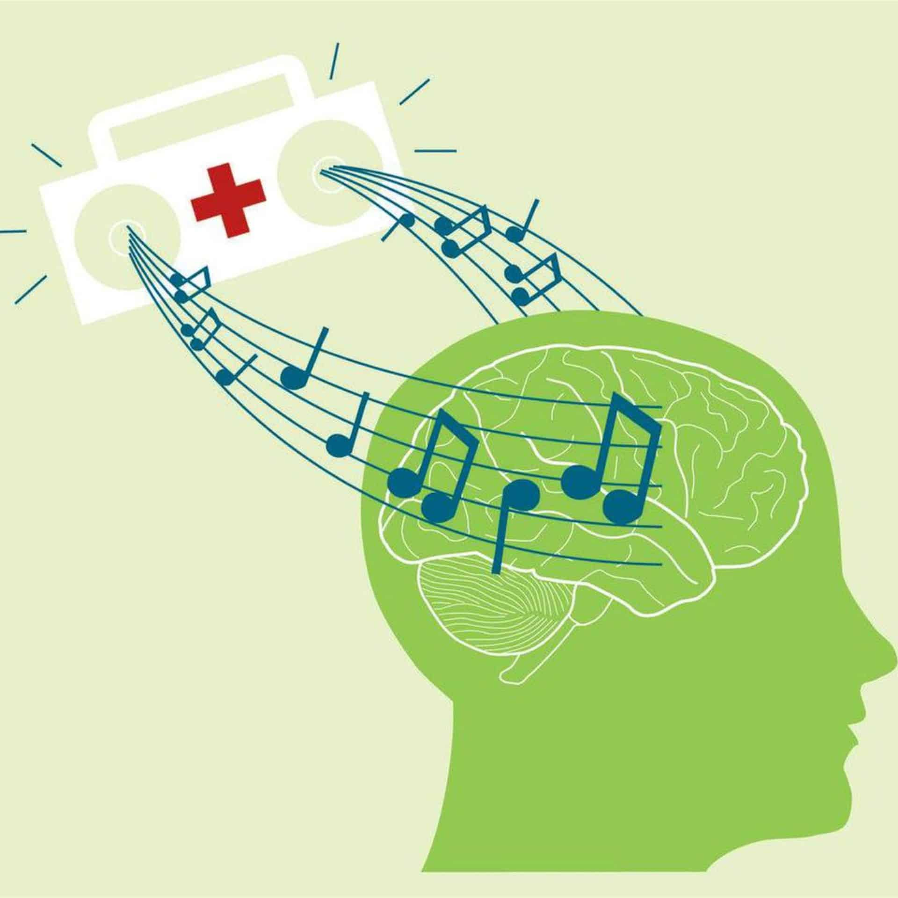
A SURVEY TO ASSESS IMPACT OF MUSIC ON PEOPLE’S MENATL HEALTH

Slide 2
INTRODUCTION
The report is designed on the basis on data obtained from survey conducted to assess the impact of music on people’s mental health & mood.The survey recorded responses from total 612 participants that mainly focuses on their musical preferences,listening habits,& overall state of mind.

Slide 3
ABOUT THE DATA
Relatively clean
Hosted at Qureos
Surveyed by JB Music Therapy

Slide 4
BASIC ANALYSIS OF DATA
Exploratory Analysis of data for getting some basic insights.
Most popular music streaming platform.
Number of Hours respondents listen to music daily.
Favourite Music Genre of Respondents.
Self reported mental health condition scores.
Correlation of music genre with self reported mental health conditions
Effect of music on mental health conditions of respondents.

Slide 5
DATA EXPLORATION
Done on MySQL using basic DML & aggregate functions.Insights we get are as :
Average age of respondents - 24.6373
Average time for which respondents listen to music(per day) – 3.72 hrs
Average BPM of songs listened by respondents – 123.95
Average anxiety score of respondents – 5.87
Average Insomnia score of respondents – 3.80
Average depression score of respondents – 4.87
Average OCD score of respondents – 2.65
Percentage of Instrumentalist among all respondents – 32.84%
Percentage of Music Composers among all respondents – 17.48%

Slide 6
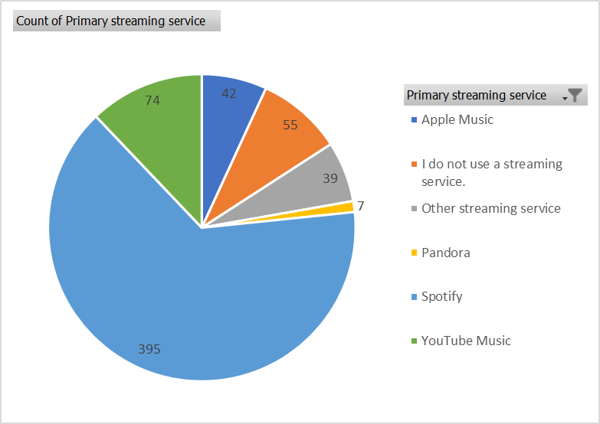
Out of 612 respondents 395 listen music on Spotify.
So,we can say that it is most popular music streaming platform

Slide 7
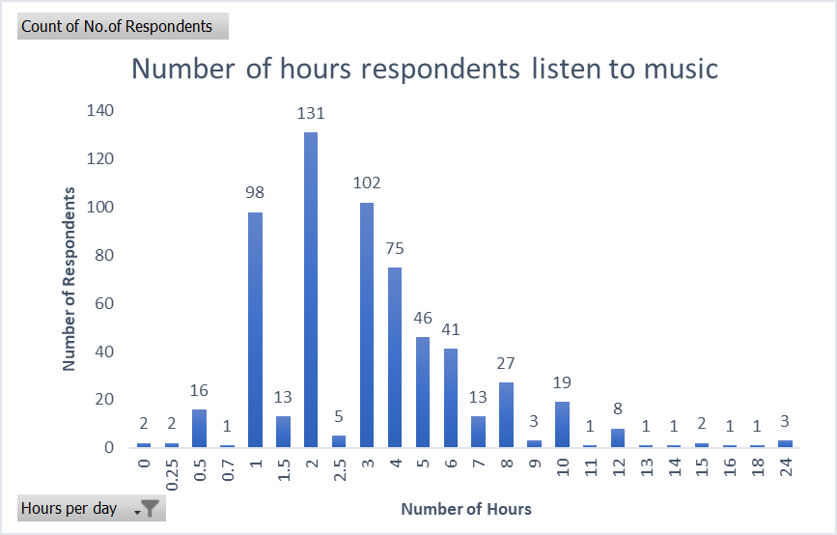
Visualization is created using Microsoft Excel

Slide 8
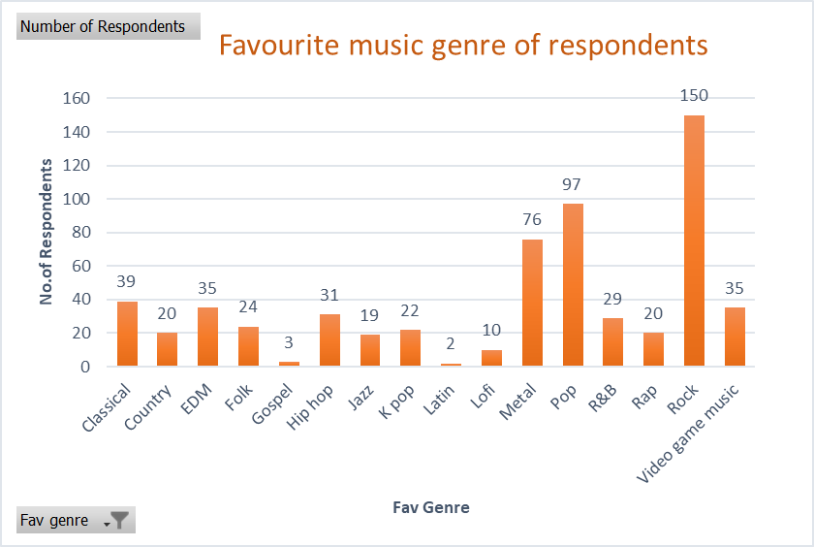
Above visualization is created using Microsoft Excel.
Here we can say that Rock is the most favourite & Latin is least favourite music genre among respondents

Slide 9
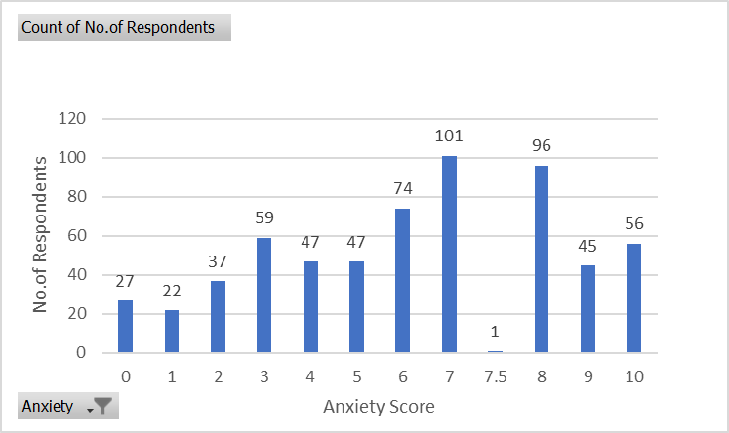
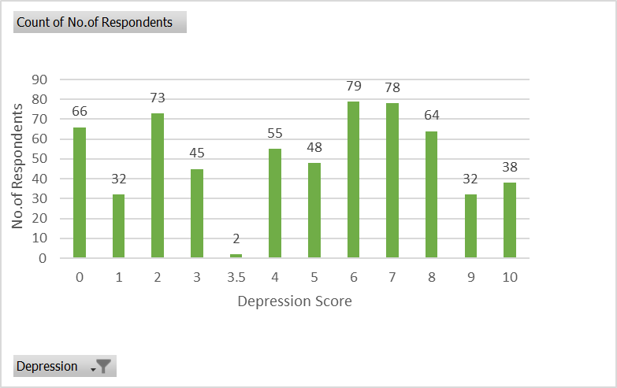
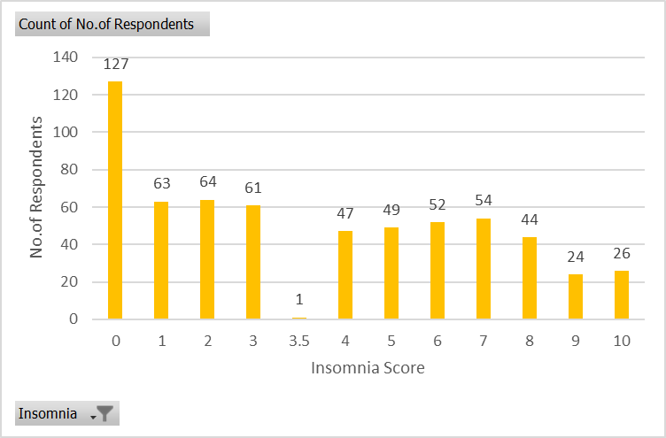
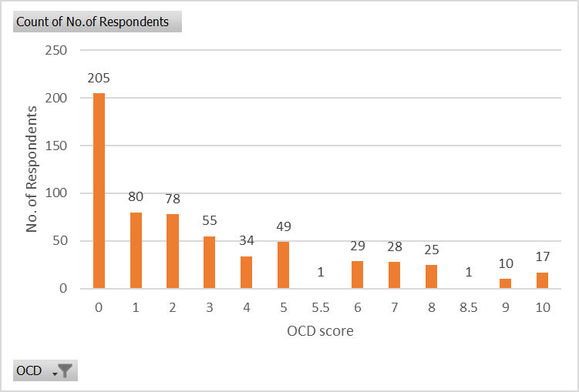
Self-reported mental health condition score of respondents

Slide 10
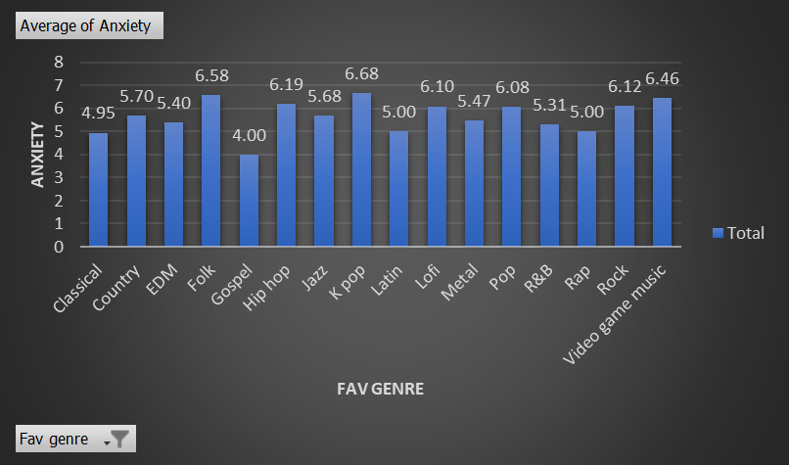
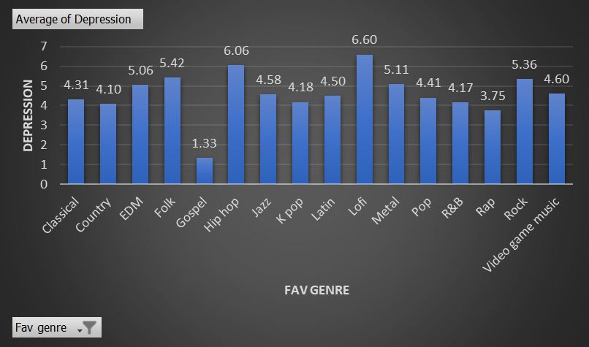
Correlation of music genre with self reported mental health conditions
Above visualization is created using Microsoft Excel.
Respondents having Gospel as their favourite music genre reported lower anxiety level on average where those having K pop reported higher level of anxiety on average.
Respondents having Gospel as their favourite music genre reported lower level of depression on average whereas those having Lofi reported higher level of depression on average.

Slide 11
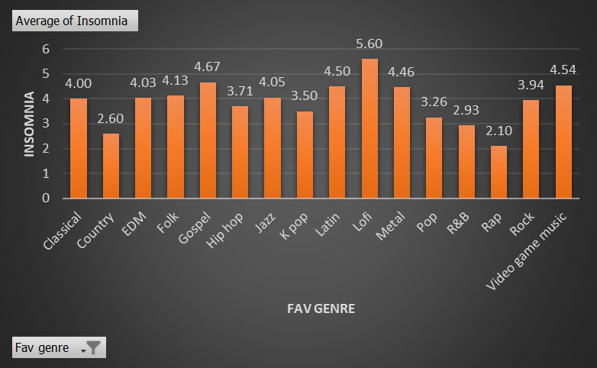
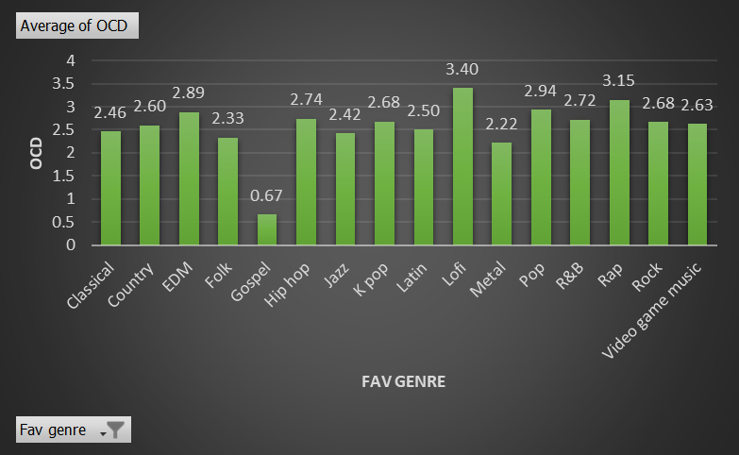
Correlation of music genre with self reported mental health conditions
Above visualization is created using Microsoft Excel.
Respondents having Rap as their favourite music genre reported lower Insomnia level on average where those having Lofi reported higher level of Insomnia on average.
Respondents having Gospel as their favourite music genre reported lower level of OCD on average whereas those having Lofi reported higher level of OCD on average.

Slide 12
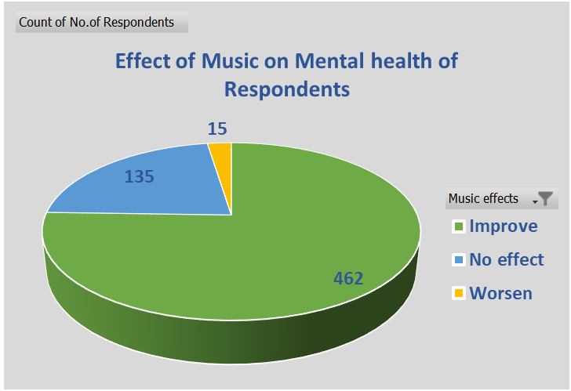
Above visualization is created using Microsoft Excel.
Majority of respondents(462 out of 612) feels that music improves their mental health .

Slide 13
OVERALL FINDINGS
As per Analysis we found that respondents with higher level of Anxiety, Depression,Insomnia & OCD prefer Lofi music due to its potential calming effects.
There exists potential correlation & connection between music preference & mental health as majority of respondents sees improvement in their mental health conditions by listening to music .

Slide 14
CHALLENGES
Due to survey being self reported in terms of mental health conditions this might not be an accurate observation.
Respondents might differ in subjective views on severity despite providing similar ratings.

